Slide 1
Introduction to Artificial Intelligence
Intelligent Agents
By
Seyed Abolghasem Mirroshandel mirroshandel@gmail.com

Slide 2
Outline
What is an intelligent agent?
Structure of intelligent agents
Environments
Agent types
Examples
Introduction to AI, Guilan University, Fall 2013, Mirroshandel@gmail.com

Slide 3
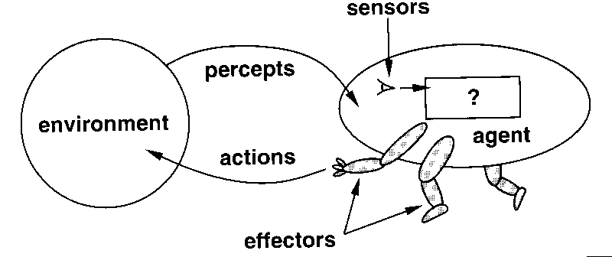
Agents
Human agent: eyes, ears, and other organs for sensors; hands, legs, mouth, and other body parts for effectors.
Robotic agent: cameras and infrared range finders for sensors; various motors for effectors.
Introduction to AI, Guilan University, Fall 2013, Mirroshandel@gmail.com

Slide 4
Rational Agent?
What action makes the agent more successful?
How to Evaluate?
  Internal / External
  You’ll get what you seek
When to Evaluate?
Introduction to AI, Guilan University, Fall 2013, Mirroshandel@gmail.com

Slide 5
Rational Agents
Rational Agent: For each possible percept sequence, a rational agent should select an action that is maximizes its performance measure.
Omniscience vs. Rationality: What does the agent know?
Introduction to AI, Guilan University, Fall 2013, Mirroshandel@gmail.com

Slide 6
Rational Agents
Rational Agent: For each possible percept sequence, a rational agent should select an action that is expected to maximize its performance measure, given the evidence provided by the percept sequence and whatever built-in knowledge the agent has.
Performance Measure
Percept Sequence
Environmental Knowledge
Possible Actions
Introduction to AI, Guilan University, Fall 2013, Mirroshandel@gmail.com

Slide 7
Autonomy
An agent is autonomous if its behavior is determined by its own experience (with ability to learn and adapt)
Autonomous: ~ not under immediate control of human
Benefits:
  Environmental Change / Training
Introduction to AI, Guilan University, Fall 2013, Mirroshandel@gmail.com

Slide 8
Primary Design Notes (PAGE)
Perceptions
Actions
Goals
Environments
Introduction to AI, Guilan University, Fall 2013, Mirroshandel@gmail.com

Slide 9
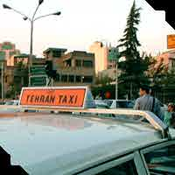
PAGE Samples…
Agent: Automated taxi driver
  Perceptions: Cameras, sonar, speedometer, GPS, odometer, engine sensors, microphone
  Actions: Steering wheel, accelerator, brake, signal, horn
  Goal: Safe, fast, legal, comfortable trip, maximize profits
  Environment: Roads, other traffic, pedestrians, customers
Introduction to AI, Guilan University, Fall 2013, Mirroshandel@gmail.com

Slide 10

PAGE Samples…
Agent: Medical diagnosis system
  Perceptions: Keyboard (entry of symptoms, findings,
  patient's answers)
  Actions: Screen display (questions, tests, diagnoses, treatments, referrals)
  Goal: Healthy patient, minimize costs
  Environment: Patient, hospital, staff
Introduction to AI, Guilan University, Fall 2013, Mirroshandel@gmail.com

Slide 11
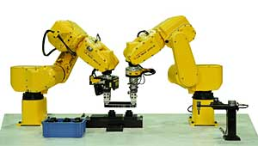
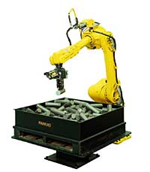
PAGE Samples…
Agent: Part picking robot
  Perceptions: Camera, joint angle sensors
  Actions: Jointed arm and hand
  Goal: Percentage of parts in correct bins
  Environment: Conveyor belt with parts, bins
Introduction to AI, Guilan University, Fall 2013, Mirroshandel@gmail.com

Slide 12


PAGE Samples…
Agent: Interactive English tutor
  Perceptions: Keyboard
  Actions: Screen display (exercises, suggestions, corrections)
  Goal: Maximize student's score on test
  Environment: Set of students
Introduction to AI, Guilan University, Fall 2013, Mirroshandel@gmail.com

Slide 13
Environment types
Fully observable (vs. partially observable): An agent's sensors give it access to the complete state of the environment at each point in time.
Deterministic (vs. stochastic): The next state of the environment is completely determined by the current state and the action executed by the agent. (If the environment is deterministic except for the actions of other agents, then the environment is strategic)
Episodic (vs. sequential): The agent's experience is divided into atomic "episodes" (each episode consists of the agent perceiving and then performing a single action), and the choice of action in each episode depends only on the episode itself.
Introduction to AI, Guilan University, Fall 2013, Mirroshandel@gmail.com

Slide 14
Environment types
Static (vs. dynamic): The environment is unchanged while an agent is deliberating.
Discrete (vs. continuous): A limited number of distinct, clearly defined percepts and actions.
Single agent (vs. multiagent): An agent operating by itself in an environment.
Introduction to AI, Guilan University, Fall 2013, Mirroshandel@gmail.com

Slide 15
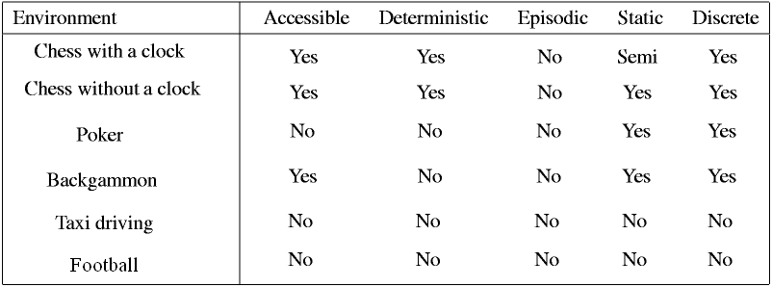
Environment types
The real world is (of course) partially observable, stochastic, sequential, dynamic, continuous, multi-agent
Introduction to AI, Guilan University, Fall 2013, Mirroshandel@gmail.com

Slide 16
Agent Program Types
Look Up Table
Simple Reflexive
Model-based reflex agents
Goal-based agents
Utility-based agents
Introduction to AI, Guilan University, Fall 2013, Mirroshandel@gmail.com

Slide 17
Look Up Table Agents
Benefits:
  Easy to implement
Drawbacks:
  Huge table
  Take a long time to build the table
  No autonomy
  Even with learning, need a long time to learn the table entries
Introduction to AI, Guilan University, Fall 2013, Mirroshandel@gmail.com

Slide 18
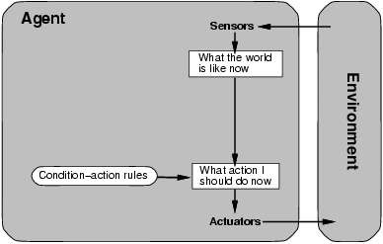
Simple Reflex Agents
Introduction to AI, Guilan University, Fall 2013, Mirroshandel@gmail.com

Slide 19
Simple Reflex Agents
function Simple-Reflex-Agent(percept) returns action
static: rules, a set of condition-action rules
state := Interpret-Input (percept)
rule := Rule-Match(state, rule)
action := Rule-Action[rule]
return action
No Memory, No planning
Introduction to AI, Guilan University, Fall 2013, Mirroshandel@gmail.com

Slide 20
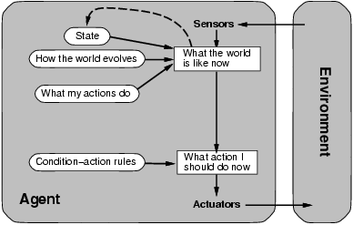
Reflex agents with states
Introduction to AI, Guilan University, Fall 2013, Mirroshandel@gmail.com

Slide 21
Reflex agents with states
function Reflex-Agent-State(percept) returns action
static: rules, a set of condition-action rules
state, a description of the current state
state := Update-State (state, percept)
rule := Rule-Match(state, rules)
action := Rule-Action[rule]
state := Update-State (state, action)
return action
still no longer-term planning
Introduction to AI, Guilan University, Fall 2013, Mirroshandel@gmail.com

Slide 22
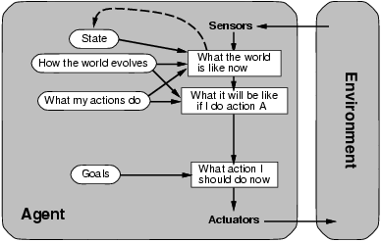
Goal-based agents
Introduction to AI, Guilan University, Fall 2013, Mirroshandel@gmail.com

Slide 23
Goal-based agents
function Goal-Based-Agent(percept, goal) returns action
static: rules, a set of condition-action rules
state, a description of the current state
state := Update-State (state, percept)
rule := Plan-Best-Move(state, rules, goal)
action := Rule-Action[rule]
state := Update-State (state, action)
return action
longer term planning, but what about cost?
Introduction to AI, Guilan University, Fall 2013, Mirroshandel@gmail.com

Slide 24
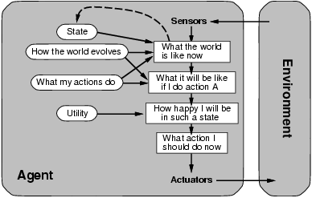
Utility-based agents
Introduction to AI, Guilan University, Fall 2013, Mirroshandel@gmail.com

Slide 25
Utility-based agents
function Utility-Based-Agent(percept, goal) returns action
static: rules, a set of condition-action rules
state, a description of the current state
state := Update-State (state, percept)
rule := Plan-Best-Move(state, rules, utility)
action := Rule-Action[rule]
state := Update-State (state, action)
return action
still no longer-term planning
Introduction to AI, Guilan University, Fall 2013, Mirroshandel@gmail.com

Slide 26
Summery
Agent
Rational Agent / Omniscience
  Percept Sequence, Knowledge,
  Performance Measures, Actions
Pre-design Notes
  Perceptions/Actions/Goal/Environment
Environment Types
Architecture Levels
Introduction to AI, Guilan University, Fall 2013, Mirroshandel@gmail.com

